Slide 1
Comparing Public transfers for Immigrants and Natives in Canada
Gilbert MONTCHO
Julien NAVAUX, Yves CARRIERE, Marcel MERETTE
Notes:
1- Good morning and Thanks for coming.
As you all know, Population aging has become the intersection of heated debates in advanced economies and one of the fierce one is the role of immigration not only as a source of additional labor supply but also as a possible solution to alleviate the pressure on public finances.
While the impact of immigration on various aspects of the labor market has been extensively researched, its fiscal impact on public finances has received less attention.
In this study, we apply the National Transfer Account(NTA) and demographic decomposition to estimate and compare public transfer for immigrants and natives in Canada between 1997 and 2015.

Slide 2
Outline
We will look at:
The NTA by Residence Status: method, data sources and measures of comparison
The difference in net transfer between Immigrants and Natives
The source of differences in transfers
Notes:
In today's presentation we’ll first look at The NTA by Residency Status: method, data sources and measure of comparison. Then we will analyse the trends in the measures over the studied period and finally we will look at the source of difference in transfer between immigrants and native.
But before getting into it, let look at some statistics of Immigration in Canada.

Slide 3
Background
Immigration in Canada: Overview
Foreign born but living in Canadian as a citizens or permanent resident
7.5 million, 22% of population is immigrant and about 61% live in Toronto, Montreal or Vancouver
62 % of recants immigrants are from Asia and 60% arrive as economic immigrants
Notes:
For the purpose of this study, an immigrant is defined as a persons born outside Canada but living in the country in Canadian as a citizens or permanent resident
The 2016 Census enumerated about 7.5 million immigrants in Canada, accounting for about 22 % of the total population. About 61% of immigrants in Canada live in the 3 metropolitan area of Toronto, Montreal and Vancouver.
Resent immigrants, that is those arrived between 2011 and 2016 are mainly from Asia, and belong to the economic category,
With that said, let look at some basic of the NTA approach and how it’s applied in this study.

Slide 4
NTA by Residence Status
The NTA fundamental equation
TGI: Education cost, Health care, Cash transfer, Other inflows
TGO : Income taxes, Sales Taxes, Social insurance, Other outflows
Notes:
This is the fundamental NTA equation that we’re all familiar with. This study focusses on the public transfer account, that is TGI and TGO and their sub accounts.
Navaux and Mérette (2020) have estimated TGI and TGO for Canada as a whole. So the first added value of this research has been to split these transfer between immigrant and natives.

Slide 5
NTA by Residence Status
For immigrants and natives
Notes:
And this is done through the following formula, where IMM and NAT stand respectively for immigrants and native, Ta represent the transfer at a given age at national level, the hat stand for the age profile of transfer (before adjustment on Ta) and the S stand for the share of the population at a given age.
This applies for native and immigrants similarly but we can just subtract the immigrant values from that of the total to get the native value.
Now where do all these data come from.

Slide 6
NTA by Residence Status
Data sources
TGO and TGI: Navaux and Mérette (2020).
Survey of Labour and Income Dynamics (SLID)
Canadian Income Survey (CIS)
Survey of Household Spending (SHS)
Canadian Community Health Survey (CCHS)
Population Censuses and Estimates
Notes:
The adjusted transfer for Canada a whole are taken from Navaux and Mérette (2020) as there are. The unadjusted profile of transfers are estimated from various surveys and census.
The estimation is straight forward for some of them. For example, unadjusted age profiles for cash transfer, are calculated from the Survey of Labour and Income Dynamics (SLID, from 1997 to 2011) and from the Canadian Income Survey (CIS, for 2012 and 2015).
Others are estimated using proxies. For example, The annual component of the Canadian Community Health Survey (CCHS) is used to construct the unadjusted age profile of health care cost using the number of total medical visits within a given year.
Now that we have the data, let look at the measure used to compare transfer between immigrants and natives

Slide 7
Difference in transfers
Measures of analysis
Notes:
The measure of comparison are Net Transfer, Immigrant Surplus and Net Surplus, defined as followed:
Let Tic be the per capita transfer for a given account and residency status
Net Transfer is defined as the sum of all transfers (inflows minus outflows) across all ages, all sub accounts included. It's computed separately for each residence status (Immigrants or Natives)
Immigrant Surplus is the difference in transfer between Immigrants and Natives for a given accounts or sub accounts of inflows and outflows.
Net surplus is the sum of all immigrant surplus across all accounts or sub accounts. It can also be viewed as the sum of all Net transfers (Immigrants minus Natives).
With this in mind, we can now look at the results.

Slide 8
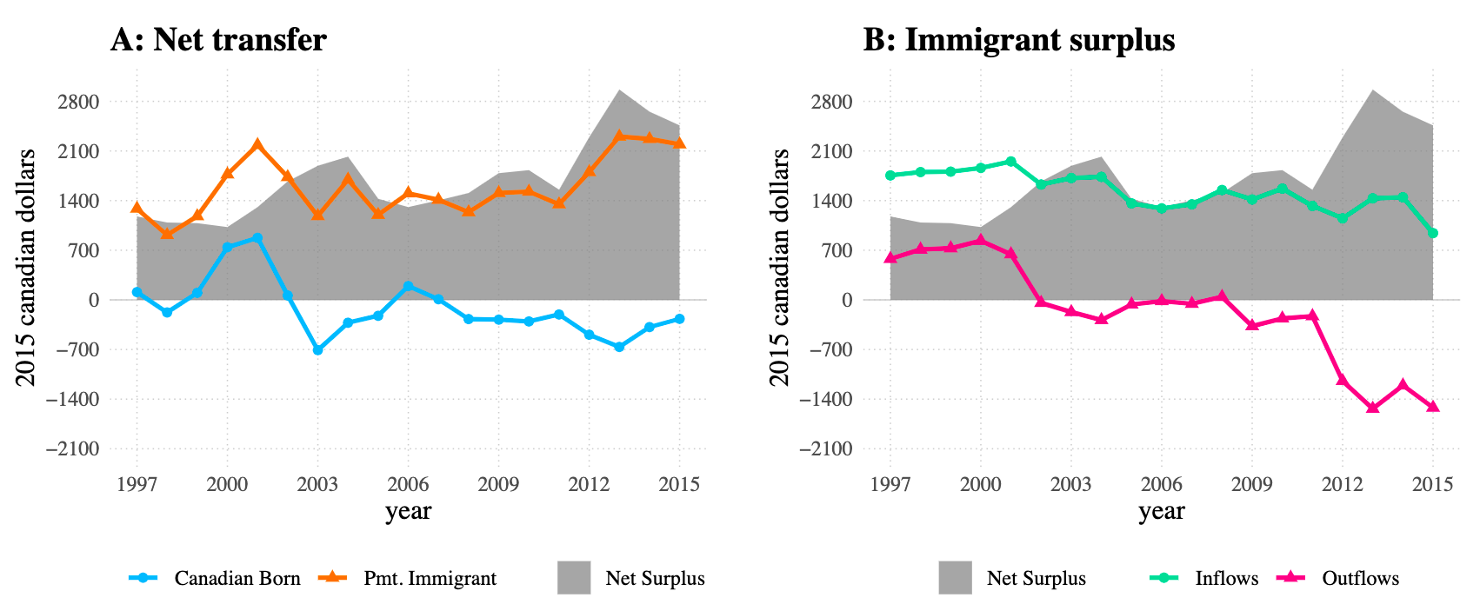
Difference in transfers
Trends between 1997 and 2015
Notes:
----Net surplus ----
Now please imagine that the lines are not there and only focuses on the grey surface, which is the Net Surplus. We can see that, prior 2012 where we have a huge increase the average net surplus of transfer has fluctuated only slightly around \$1400 since 1997. A positive net surplus of transfer implies that the average immigrant has cost to the state more than the average native. However this overall positive cost hide important differences in trends within each group and transfer components.
----Net transfer ----
Let now look at the lines in Figure A, which are the net transfer for immigrants and native.
On one hand, We can see that Immigrants have had a positive net transfer over the studied period. This positive net transfer for immigrant imply that they have received more transfer from the state than they contribute to its revenues. On the other hand, Natives have also seen much lower and slightly negative net transfer over the studied period. a sign that they have contributed more to the public purse than they received from it.
Putting these observation together it can be concluded the trend in net surplus is due to the fact that immigrants have consistently received more than they contributed while natives has received slightly less than they contributed. However we still don’t know, how the difference between immigrants and natives is distributed among outflows and inflows. These differences can be further understood by analysing the trend in Immigrant surplus for each transfer components in figure B.
----Immigrants surplus ----
Here we see that, Over the studied period, Immigrant surplus for inflow has been positive but is trending down. For instance, Immigrant surplus for inflow has drop by about about half between 1997 and 2015 and if the surplus for outflows followed the same trend or even constant, the net surplus would have reduced and even reversed direction by 2015. Instead, the surplus for outflows has increased greatly between 1997 and 2015, and especially from 2011 result in the spike we saw in net surplus.
---- Summary----
Till now we know the difference between Immigrants and native in net transfer is largely du to the difference in outflows. But how this difference is shared among various sub accounts of inflows and outflow still unclear.

Slide 9
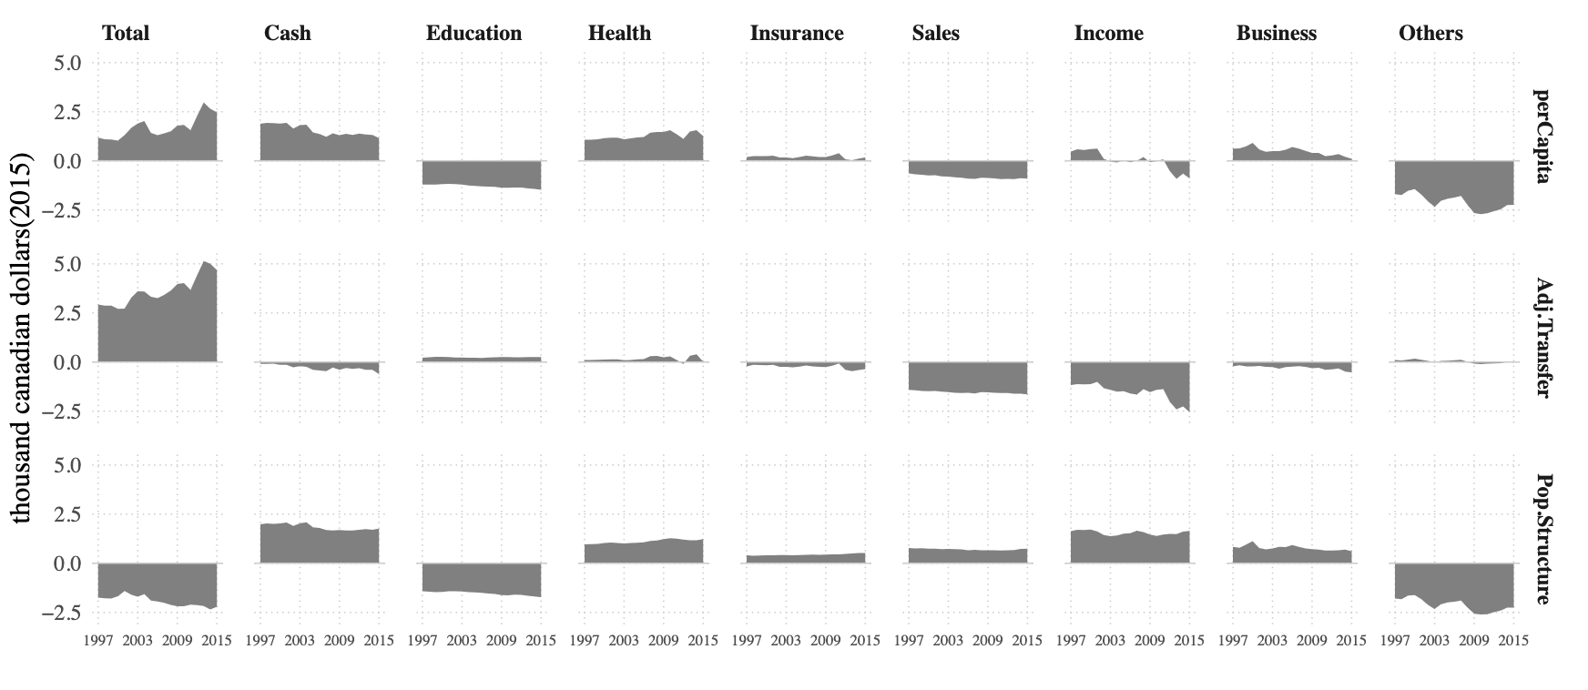
Source of Surplus
Immigrants Surpluses (Crude)
Inflows
Outflows
Notes:
When we look directly at the immigrants surplus for each sub account of inflows and outflow, we see a rather strange picture.
----crude----
Looking of the graphic, we see elements of inflow actually show larger surplus than those of outflows. Which is not even consistent with the literature. For instance the labor market has been reported to be the source of inequality between immigrants and natives. So we were expecting that sub account that are related to labor market outcome such taxes on income and sales to show some level of inequality.
And that where the demographic decomposition come in.

Slide 10
Source of Surplus
The model of continuous changes
Horiuchi, (2008)
Notes:
The model of continuous change developed by Horiuchi, 2008, allows to decompose the difference between two summary measures resulted from the same process into a number of components, each representing the contribution of the factors intervening in the process. The process is functional, taking values of the factors (the covariates) and returning a summary measure (the dependant variable).
Horiuchi, 2008 demonstrate that the difference between the summary measures can be decomposed into addictive components representing the contribution of the change within each covariate toward that difference, even if the process is a non addictive function of the covariates.
Now recall that our per capita transfer is a function of the age specific population share on one hand and transfer on the other hand. Using this as the functional process, the immigrant surplus can be written as the difference between two summary measures one for immigrants and the other for natives.

Slide 11
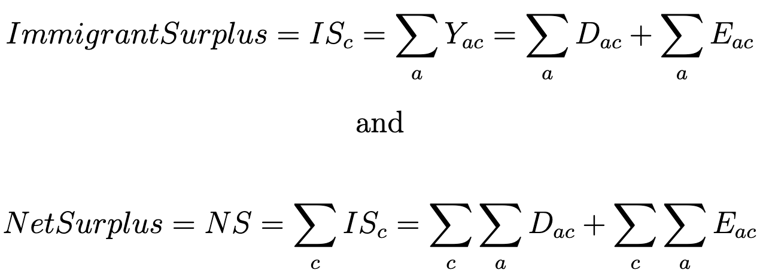
Source of Surplus
The model of continuous changes
Notes:
The immigrants surplus is decomposed by creating a wrapper function g around the R package DemoDecomp Which take as arguments, the per capita function f, Immigrants covariates for immigrants and natives.
And return a matrix Yac composed of Dac the demographic components and Eac the economic components representative
The elements of Yac can then be summed up to re build the immigrants surplus for a given account or sub accounts and the net surplus, as well as their respective Demographic and economic components

Slide 12
Source of Surplus
Crude Versus Age-adjusted Surplus
Notes:
----Adjusted---
Looking at the adjusted transfers, We now a much reasonable picture, as much of what appeared as difference in public transfer are actually differences in age structure of the two populations.
Let first look at the total column
Results show that adjusted Net surplus followed the same trend as per Capita Net surplus but the levels are much higher in absolute values. Furthermore, the overall negative sign for demographic components of net surplus indicates that age structure is much favorable to immigrants, transfer wise, as it reduced the difference between immigrant and natives from the adjusted value to the per capita value.
But what is more interesting is that adjusting for difference in age structure actually reveal, that the sub account of sales and Income taxes are the two most important sources of disparities between immigrants and natives, accounting for 85% of of the difference in net surplus.
----As a side note--
Making the analogy with concepts used in epidemiology, age-specific and age-adjusted transfers are to the per Capita surplus, what age-specific and age-adjusted mortality rates are to crude mortality rate.

Slide 13
Conclusion
Main Findings:
Immigrants cost a lost more than natives
Labor market imbalances are the source of cost
Per capita NTA transfer are biased for comparison
Notes:
These results from this study show that immigrants cost much in public finances than natives but that the difference in age structure between the two populations account for much of the total surplus. Labor Market Imbalances are indeed the main source the cost of immigration. But are not revealed until the effect of age structure is taken out. Therefore, Per capita comparison of NTA accounts across groups may be heavily biased if when demographic structure is not the same for the compared groups.

